Slide 1
The purpose for this PPT is to provide additional information about the project (mentioned in the contents table) which could be further helpful for the user to understand.
This template is not to be used for other purposes and its rights are solely owned by the owner of the project- “DEEPAK YADAV”
This project has been published on many other platforms and is represented as a unique idea already, any violation towards copying/malpractice or etc, of this project could lead to violating the license provided.

Slide 2
Contents
Introduction
Literature Review
Existing System
Problem Statement & Objectives
Proposed System
Block Diagram
Hardware & Software Specification
Advantages
Application
References
11/28/22

Slide 3
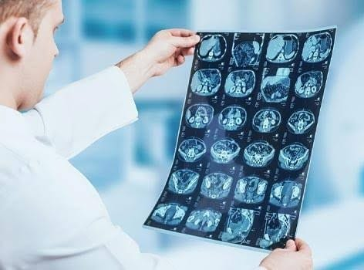
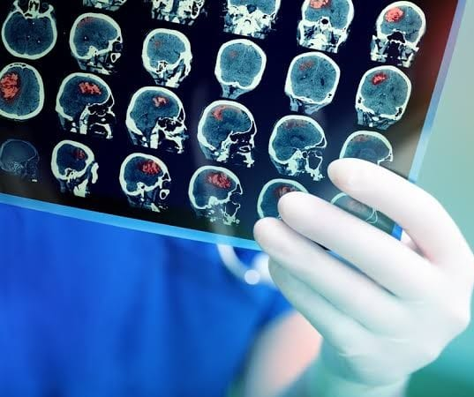
Introduction
Image or Object Detection is a computer technique that analyses images to detect items within them.
Image recognition is AI's ability to detect, classify, and recognize objects.
Face recognition is one of the best examples of image recognition systems; for example, to unlock your smartphone, you must allow it to scan your face.
AI is capable of guiding the image by sample testing.
Image recognition can be quite useful when used in medical background for diagnoses purposes.
Image recognition with the help of MATLAB simulink
11/28/22

Slide 4
Literature Review
Title of the paper | Author and year of publication | Outcome | Limitation
Rethinking the inception architecture for computer vision | Vanhoucke and Shlens J (12-12-2016) | The capacity of AI to identify, categorize and recognize objects | Soft tissue contrast using image processing is tough
Advancement of quantitative imaging | Buckler AJ, Bresolin L (2016) | Extraction of measurable information from radiology | Limited procedure and time consuming and detection is possible only to a certain range
Deep learning for medical image processing | Razzak MI , Zaib A (2018) | Categories of image retrieval, image creation , image analysis and image based visualisation | Requires large amount of data in term of precision requirements
11/28/22

Slide 5
Existing System
CT scan(computed tomography) was one of the method used in the field of medical imaging. It was discovered by Godfrey Hounsfield in 1979. Here 3d pictures of an object are represented in 2D form. It is done by converting electrical energy into X-ray photons.These photons are passed through the object and are then converted back to electrical energy. The number of X-rays that pass through the object is inversely proportional to the density of the object. Objects (such as human beings) imaged by CT consist of parts that vary in density.
11/28/22

Slide 6
Problem Statement & Objectives
Problem Statement:
Recognition of Tumor tissues using image recognition in MATLAB Simulink
Objectives:
The MRI image of the brain infected with tumor is to be scanned for tumor and the tumor is to be detected revealing the infected part by the help of an outline and a separate image of only tumor is to be displayed
11/28/22

Slide 7
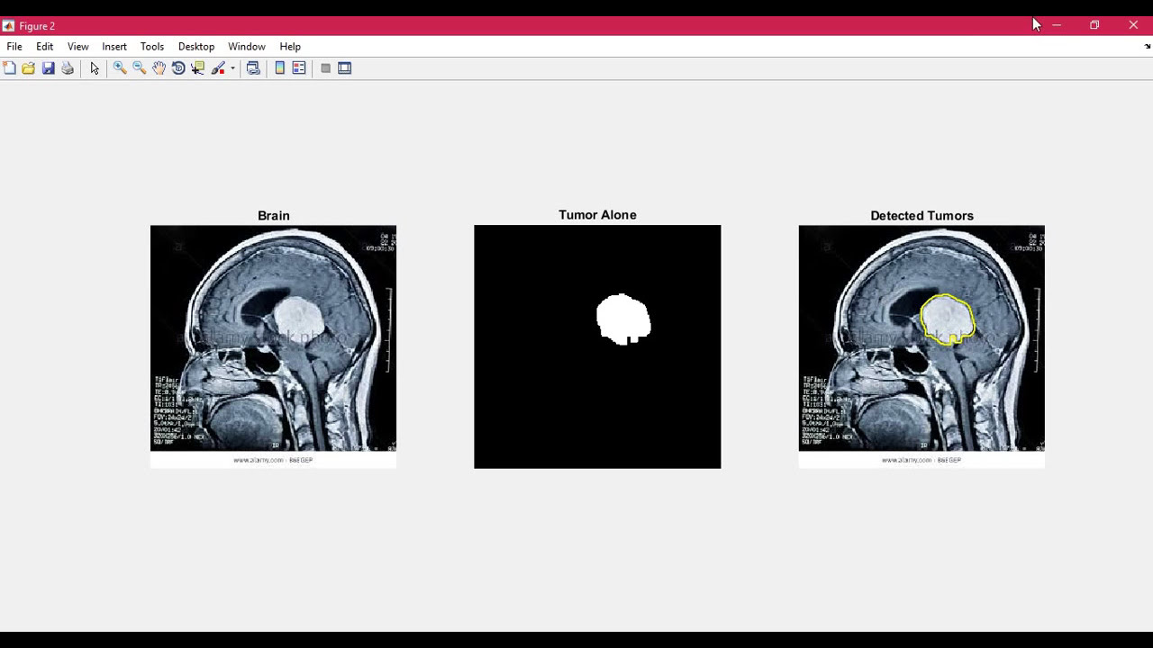
Proposed System
The image processing in the proposed system is done using basic techniques like density scan. Here the image is taken in and is divided into multiple rows and columns where each and every area in the cross section is verified for density above 0.5DPI which depicts the tumor tissue. The region is then verified and is marked. This region is then showcased separately to determine the size and the area covered by the tumor. The processed image is shown with marked layout of the tumor.
11/28/22

Slide 8
Block Diagram
The original image with the layout of the tumor is also showcased
Enter the image
Classify the image by setting a threshold into black and white
We then decide the age of tumor based on relative density of the brain
We then compare the labelled part with tumor density
The detected tumor is labelled
11/28/22

Slide 9
Software Specification
Operating system: Windows 11, Windows 10
Processor: Intel or AMD x86-64 processor
RAM: minimum= 4GB, 8GB(recommended)
Storage: 4GB for MATLAB, 8GB for installation
MATLAB Simulink software provides the user with an Image Processing Toolbox which consists of Industry standard algorithm and apps for image processing, visualization and algorithm development.
The inbuilt toolbox is capable of processing 2D, 3D objects.
It allows image processing algorithm to be segmented.
11/28/22

Slide 10
ADVANTAGES
Advantages:
It has reasonable Computing Time compared to basic processing methods.
Error ratio is small compared to reliable methods.
Image processing becomes easier because of superior Fourier properties
It is Cost effective and user friendly development of software for medical image processing.

Slide 11
APPLICATION
Applications:
We can obtain CT scans from patient-specific cases of aortic dissections and predict the growth of unnecessary muscles .
Simpleware ScanIP is used to reconstruct patient geometry, including noise processing and segmentation of locations of interest such as the brain tumor upgrowth.
Scripting is used to execute smoothing algorithms automatically in order to remove pixelation problems in medical cryptography.
Surface models are created from the brain tumor and integrated using ANSYS software

Slide 12
References
[1] Szegedy, C.; Vanhoucke, V.; Ioffe, S.; Shlens, J.; Wojna, Z. Rethinking the Inception Architecture for Computer Vision. In Proceedings of the 2016 IEEE Conference on Computer Vision and Pattern Recognition (CVPR), Las Vegas, NV, USA, 12 December 2016; pp. 2818–2826. [Google Scholar] [CrossRef][Green Version
[2] Buckler AJ Bresolin L Dunnick NR, et al.. A collaborative enterprise for multi-stakeholder participation in the advancement of quantitative imaging. Radiology. 2011;258:906–914. [PubMed] [Google Scholar]
[3] Razzak MI, Naz ZS, Zaib A (2018) Deep learning for medical image processing: overview, challenges and the future. Classification in BioApps: automation of decision making. Springer, Cham, Switzerland, pp 323–350. https://doi.org/10.1007/978-3-319-65981-7_12
[4] Y. LeCun, Y. Bengio, G. Hinton ,AI ,Nature, 521 (2015), pp. 436-444
11/28/22

Slide 13
THANK YOU

